Slide 1

20
25
CRISIS MANAGEMENT
&
BUSINESS STRATEGY
USING
SQL & POWER-BI
An analytical study on crisis identification, response planning, and strategic decision-making to minimize impact and drive organizational resilience.

Slide 2






ABOUT ME
DEEPAK BEHERA
Aspiring Data Analyst
Proficient in SQL, Python, Advanced Excel, Power BI, and statistical analysis
Delivered insights via KPI dashboards, ad-hoc reporting, and executive presentations
Solved business case studies using structured, MECE-based frameworks and hypothesis-driven analysis.

Slide 3

INTRODUCTION
2025
Situation
Quick Bite Express, a Bengaluru-based food-tech startup, had established steady growth by connecting customers with local restaurants and cloud kitchens. In June 2025, the company faced operational stress during peak monsoon season.
Complication
Food safety violations at partner restaurants and a week-long delivery outage triggered viral social media backlash. This led to rapid customer churn, declining orders, loss of restaurant partners, falling satisfaction scores, and rising customer acquisition costs, while competitors aggressively captured market share..
Resolution
A data-driven turnaround strategy was implemented to identify recoverable customer segments, fix delivery and food safety gaps, rebuild trust through targeted campaigns, strengthen high-value restaurant partnerships, and monitor recovery using core performance metrics.

Slide 4
BUSINESS IMPACT
01
05
Significant drop in active users and daily orders.
Rising customer acquisition and recovery costs.
02
Sharp decline in customer satisfaction and trust
04
Loss of partner restaurants to competing platforms
03
Increased delivery delays, cancellations, and SLA breaches

Slide 5
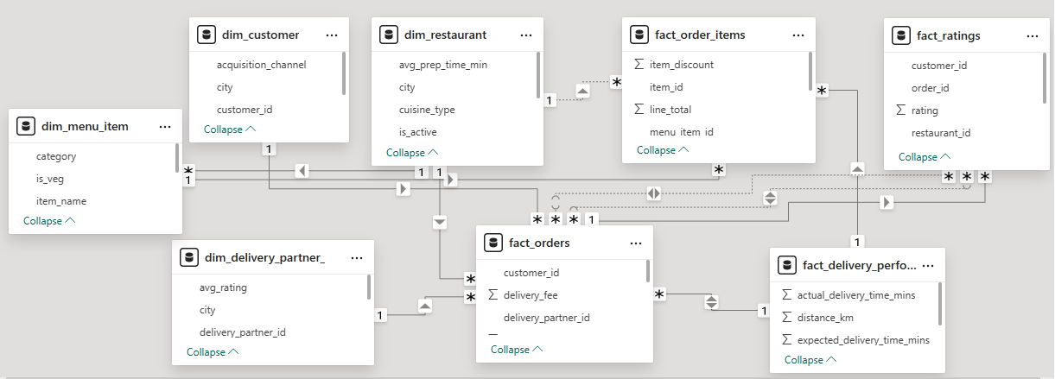
DATA MODELING

Slide 6

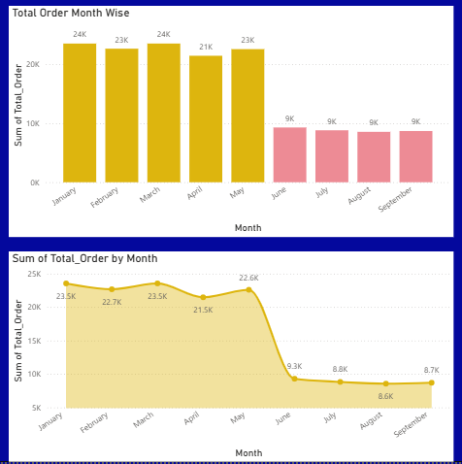
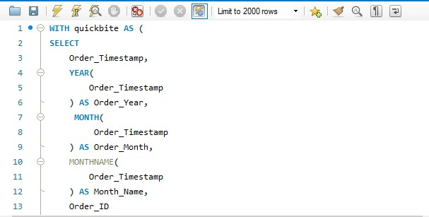
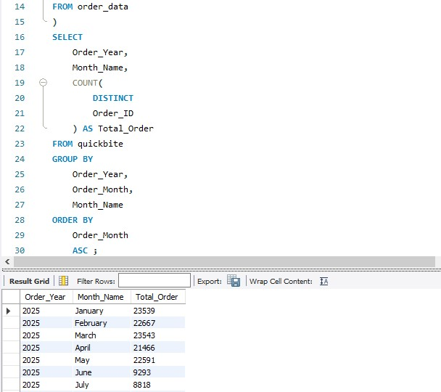
01
Compare total orders across pre-crisis (Jan–May 2025) vs crisis (Jun–Sep 2025). How severe is the decline?
Total orders declined by approximately 60–65% from May to June, falling from around 23–24K to about 9K, indicating a sharp mid-year drop in demand.
MCKINSEY STRATEGIC PLANNING

Slide 7
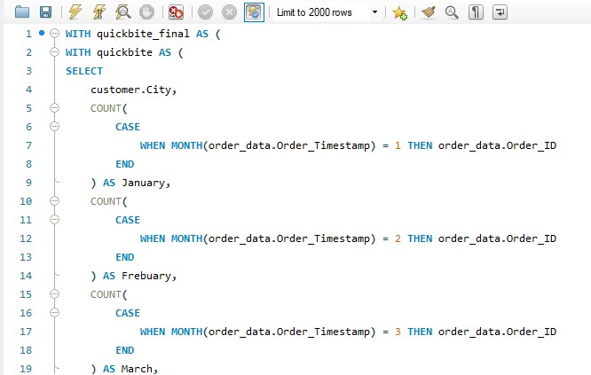
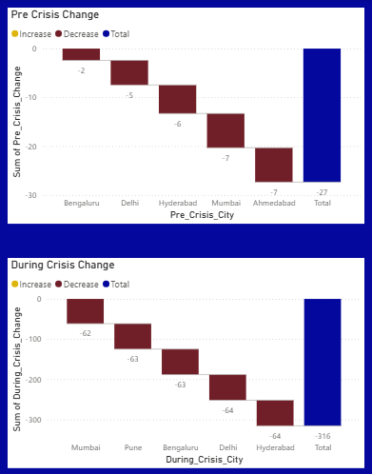
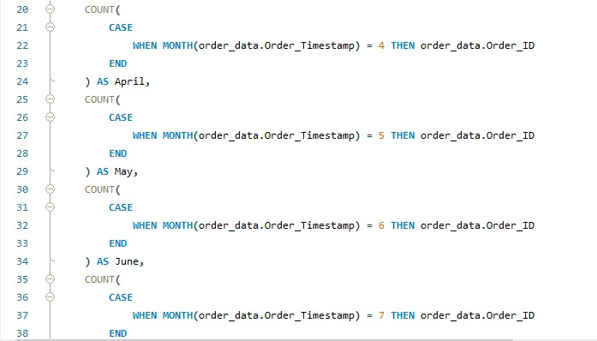
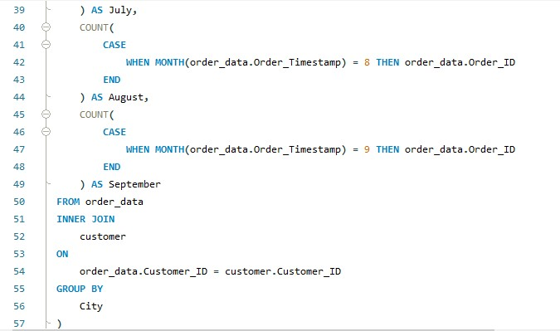
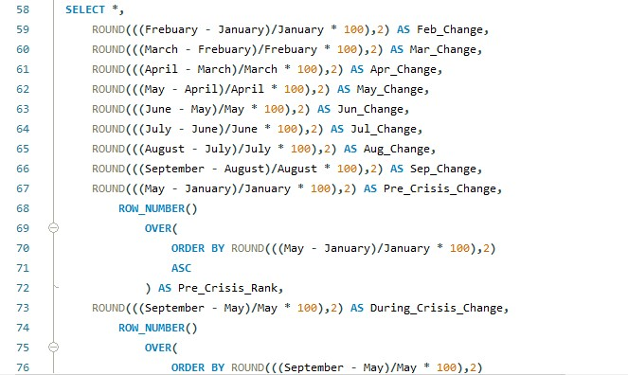
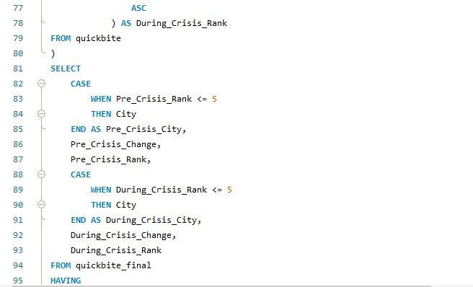
02
Which top 5 city groups experienced the highest percentage decline in orders during the crisis period compared to the pre-crisis period?
While pre-crisis order declines were marginal (~27% cumulative), the crisis triggered a severe ~316% cumulative drop, with all major cities experiencing a sharp and simultaneous demand collapse.
MCKINSEY STRATEGIC PLANNING

Slide 8
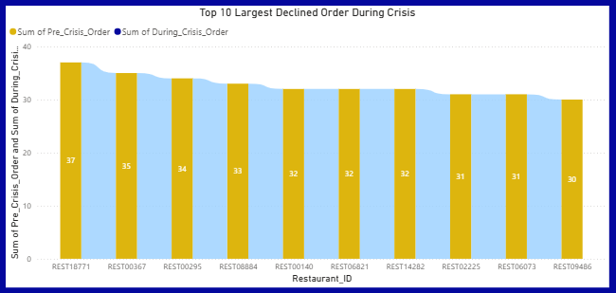
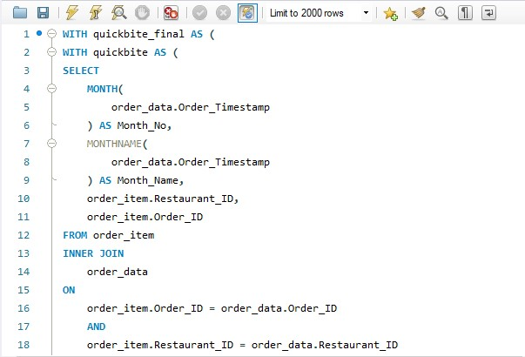
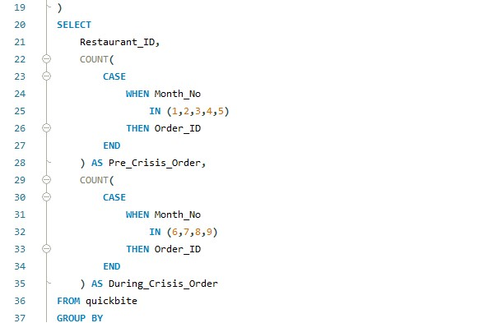
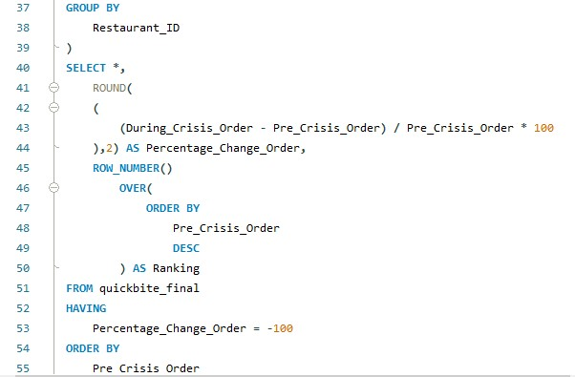
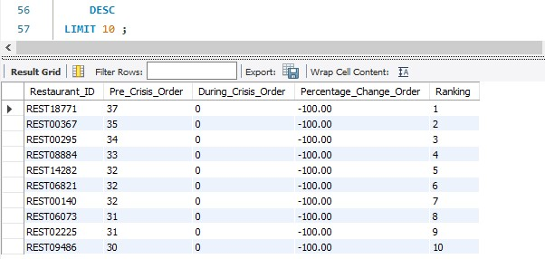
03
Among restaurants with at least 50 pre-crisis orders, which top 10 high-volume restaurants experienced the largest percentage decline in order counts during the crisis period?
The top 10 restaurants experienced a consistent and steep order decline during the crisis, with volumes dropping from ~37–30 pre-crisis to significantly lower levels, indicating widespread demand contraction rather than isolated underperformance.
MCKINSEY STRATEGIC PLANNING

Slide 9
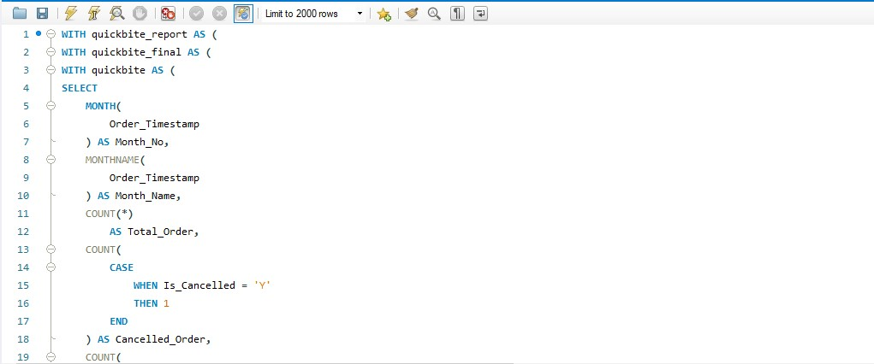
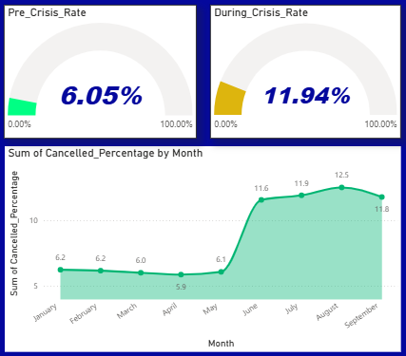
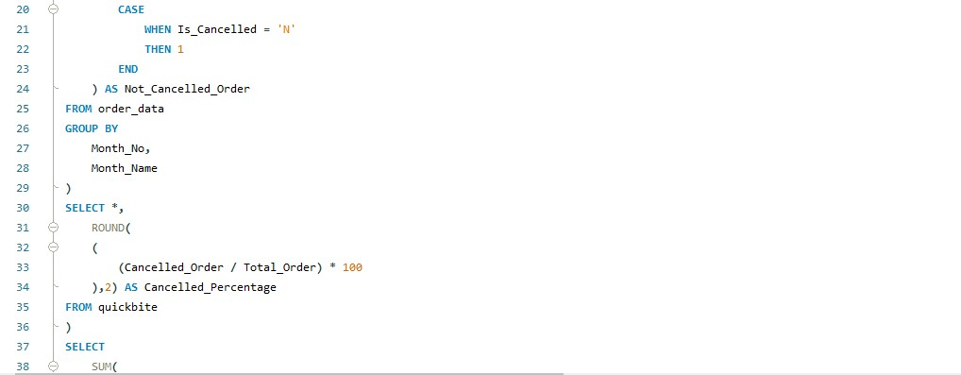
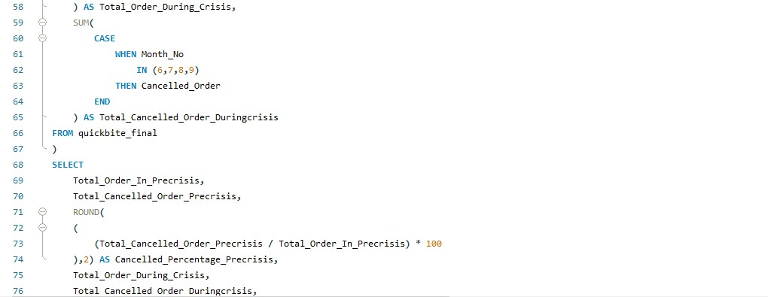
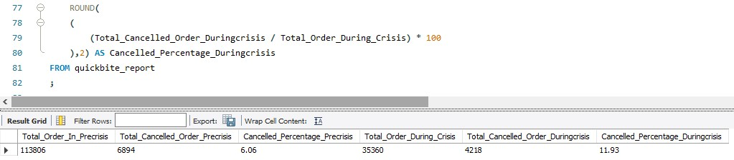
04
What is the cancellation rate trend pre-crisis vs crisis, and which cities are most affected?
Cancellation rates nearly doubled during the crisis (6.05% → 11.94%), with a sharp mid-year spike, signalling a significant decline in customer reliability that requires immediate corrective action.
MCKINSEY STRATEGIC PLANNING

Slide 10
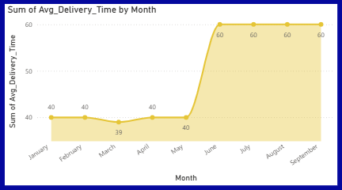
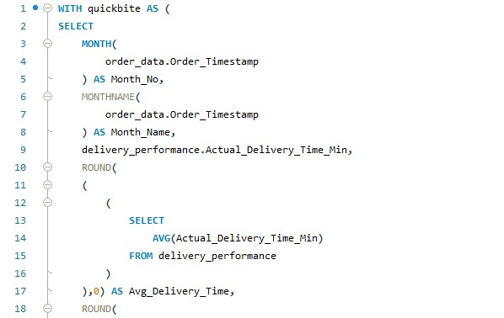
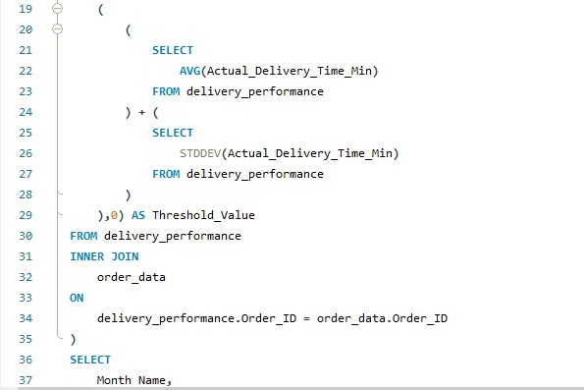
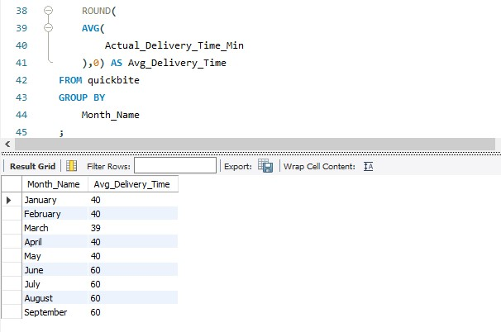
05
Measure average delivery time across phases. Did SLA compliance worsen significantly in the crisis period?
Average delivery time remained stable early in the year (~40 mins) but surged sharply from June onward (~60 mins), indicating a clear operational bottleneck during the crisis period that needs immediate optimization.
MCKINSEY STRATEGIC PLANNING

Slide 11
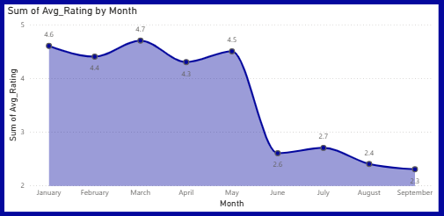
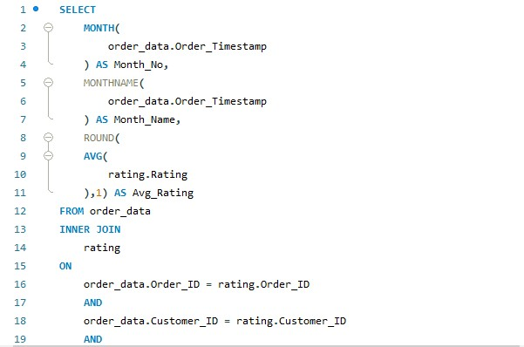
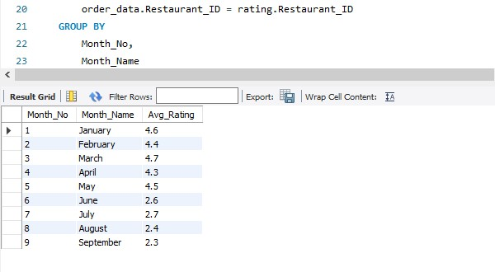
06
Track average customer rating month-by-month. Which months saw the sharpest drop?
Customer ratings were strong pre-crisis (~4.5) but dropped sharply from June onward to ~2.3–2.7, signaling a significant deterioration in customer experience during the crisis that demands urgent service quality interventions.
MCKINSEY STRATEGIC PLANNING

Slide 12
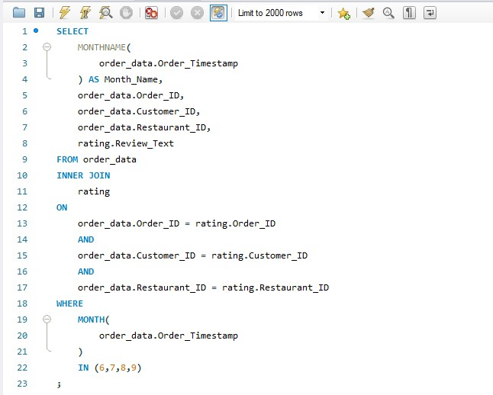
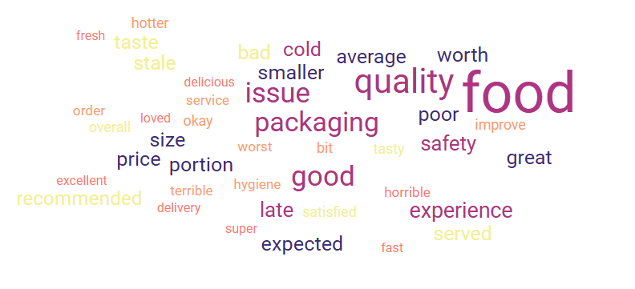
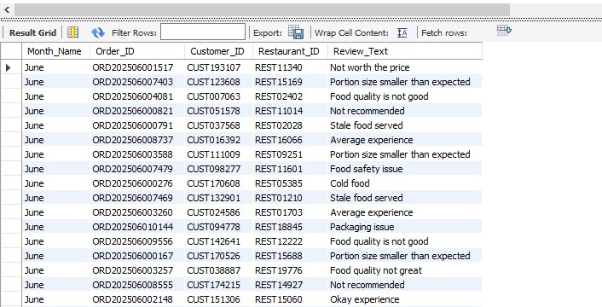
07
During the crisis period, identify the most frequently occurring negative keywords in customer review texts. (Hint: Use a Word Cloud visual in Power BI to visualize the findings.)
Customer feedback is dominated by food quality and packaging issues—frequent mentions of “cold,” “late,” and “poor quality” highlight execution gaps, despite pockets of positive sentiment around taste and value.
MCKINSEY STRATEGIC PLANNING

Slide 13
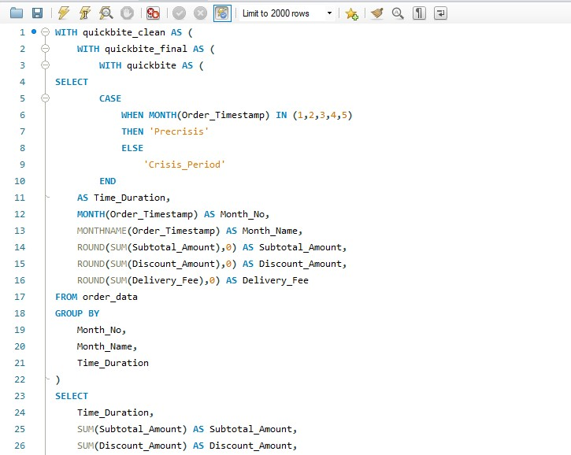
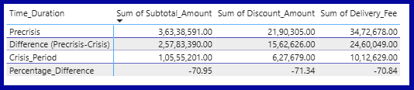
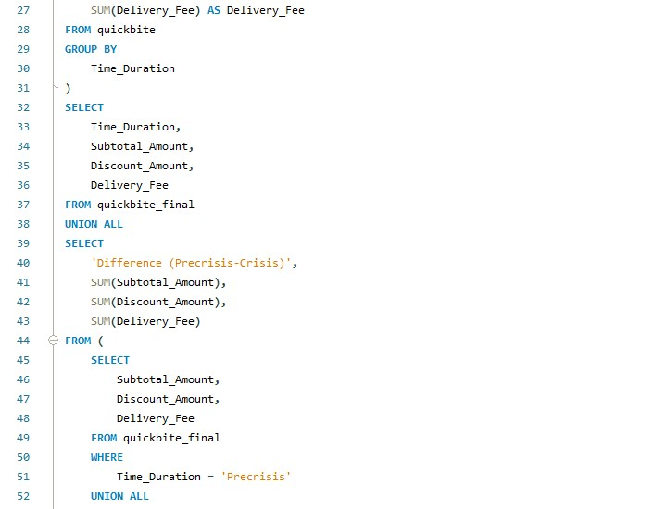
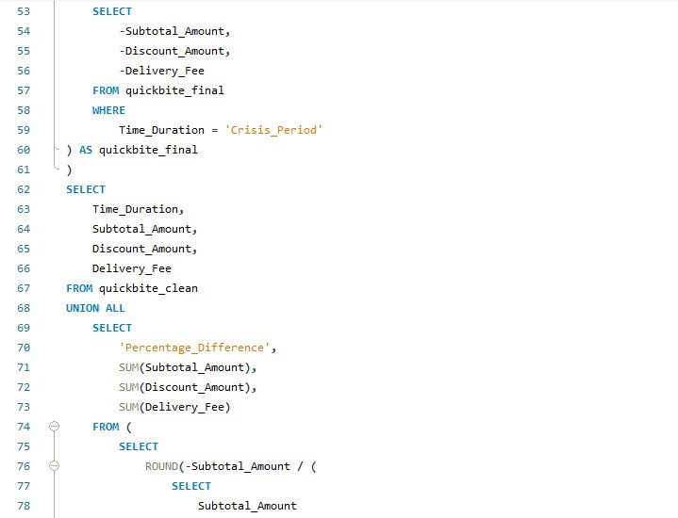
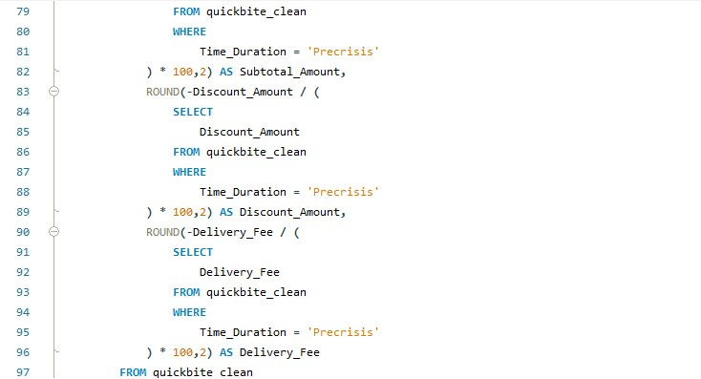
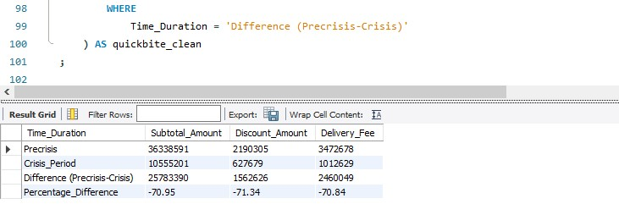
08
Estimate revenue loss from pre-crisis vs crisis (based on subtotal, discount, and delivery fee).
During the crisis period, revenue, discounts, and delivery fee collections declined by ~70% versus pre-crisis levels, indicating a severe demand and monetization shock rather than a pricing or fee-led issue.
MCKINSEY STRATEGIC PLANNING

Slide 14
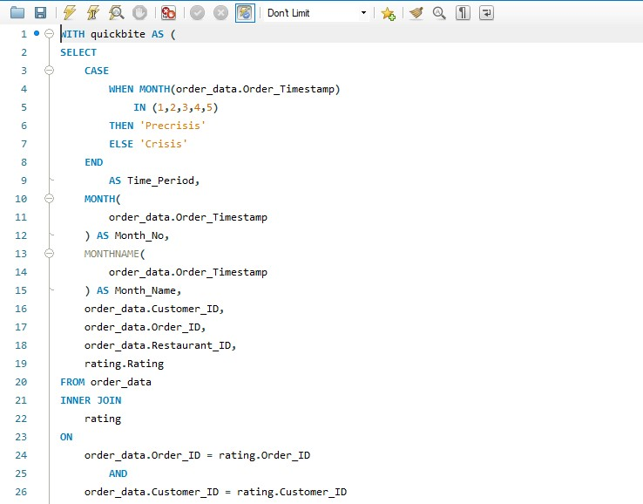
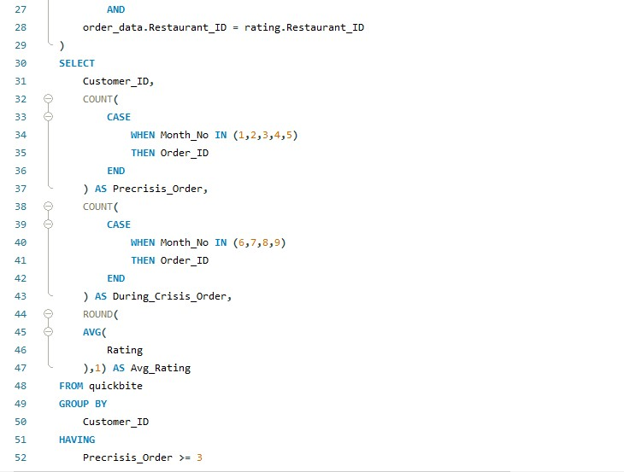
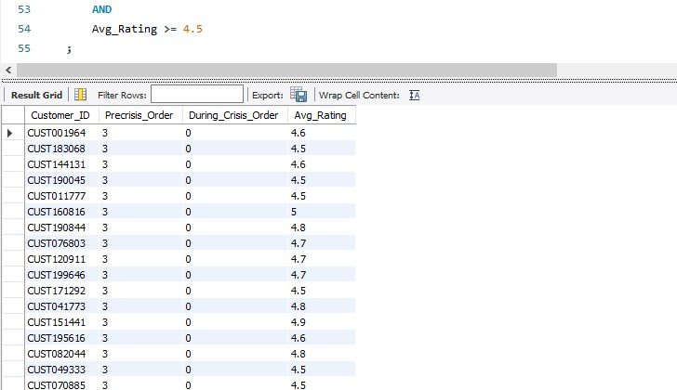
09
Among customers who placed five or more orders before the crisis, determine how many stopped ordering during the crisis, and out of those, how many had an average rating above 4.5?
MCKINSEY STRATEGIC PLANNING

Slide 15
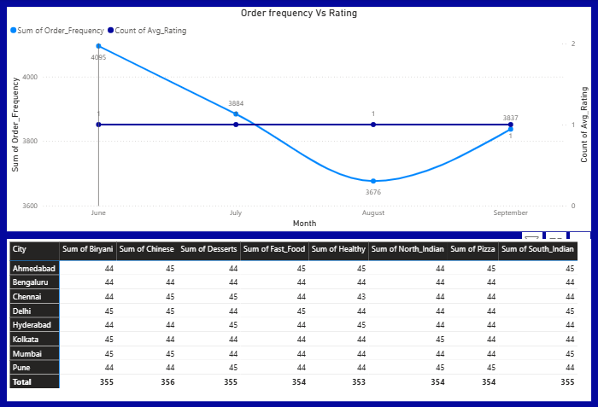
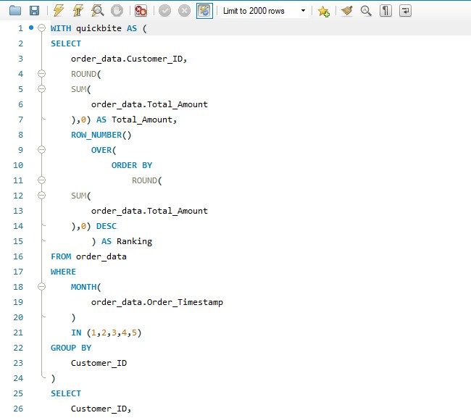
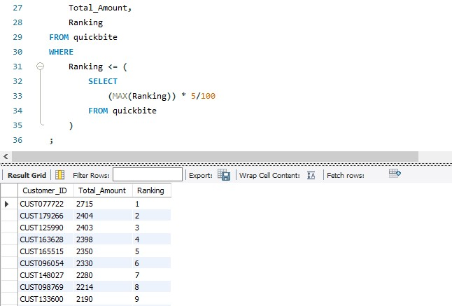
10
Which high-value customers (top 5% by total spend before the crisis) showed the largest drop in order frequency and ratings during the crisis? What common patterns (e.g., location, cuisine preference, delivery delays) do they share?
Order frequency dipped sharply in August despite stable ratings, indicating demand sensitivity driven more by operational or external factors than customer satisfaction.
MCKINSEY STRATEGIC PLANNING

Slide 16
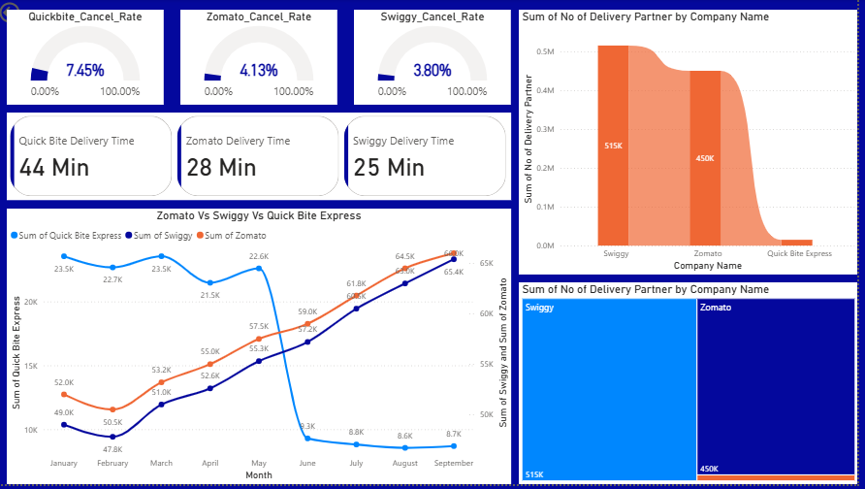
11
EXECUTIVE SUMMARY
MCKINSEY STRATEGIC PLANNING
QuickBite’s crisis is driven by significantly higher cancellation rates (7.45% vs ~4%), slower delivery times (44 mins vs 25–28 mins), and a weaker delivery partner base—while Swiggy and Zomato leveraged scale and operational efficiency to grow volumes during the same period.

Slide 17

12
Recommendations using McKinsey 7S Model
Prioritize low cancellation & fast delivery players (Swiggy, Zomato) to defend market share and improve customer trust.
Strategy
Skills
Structure
Strengthen capabilities in predictive analytics (forecast delivery delays & cancellations).
Create a dedicated performance governance cell for delivery partners (SLA, cancellation, ratings).
01
07
02
Staff
Systems
Upskill operations & analytics teams on SQL + Power BI-based performance monitoring.
06
03
Implement real-time KPI dashboards (Cancellation %, Avg Delivery Time, Rating) for daily decision-making.
05
04
Style
Shared Values
Shift leadership focus from volume-led growth to experience-led execution.
Reinforce “Speed + Reliability = Customer Trust” as the core operating principle.
MCKINSEY STRATEGIC PLANNING

Slide 18
0-90 DAYS
09-18 MONTHS
Rebuild Trust & Economics
Smarter incentives
Reward reliability
Improve partner retention
Stabilize the Core
Fix delivery delays
Reduce cancellations
Win back valuable customers
Redesign for Resilience
Go hyperlocal
Use data proactively
Reduce ad dependence
03-09 MONTHS

Slide 19




POINT 01
POINT 02
POINT 03
POINT 04
Fix Delivery Speed Gap (Primary Driver)
Reduce Cancellation Rate Through Reliability
Strengthen Supply Side (Partner Density)
Recover Demand via Experience-Led Retention (Not Discounts).
KEY POINTS

Slide 20

“DATA IS A COMPANY’S MOST STRATEGIC ASSET IN THE AGE OF AI , AND LEVERAGING IT EFFECTIVELY IS CRUCIAL FOR COMPETITIVE AND DECISION - MAKING"
SATYA NADELLA,
CEO of Microsoft

